Slide 1

BLINKIT ANALYSIS
USING MS EXCEL
MEENAA SURUTHI S

Slide 2
BUSINESS REQUIREMENTS
To conduct a comprehensive analysis of Blinkit’s sales performance, customer satisfaction and inventory distribution to identify key insights and opportunities for optimization using various KPI’s and visualizations in MS EXCEL.

Slide 3
KPI REQUIREMENTS
TOTAL SALES: The overall revenue generated from all items sold.
AVERAGE SALES: The average revenue per sale.
Number of Items: The total count of different items sold.
AVERAGE RATING: The avg customer rating for items sold.

Slide 4
CHARTS REQUIREMENTS
Total Sales by Fat Content
Total Sales by Item Type
•Objective: Analyze the impact of fat content on total sales.
•Additional KPI Metrics: Assess how other KPIs (Average Sales, Number of Items, Average Rating) vary with fat content.
•Chart Type: Donut Chart.
•Objective: Identify the performance of different item types in terms of total sales.
•Additional KPI Metrics: Assess how other KPIs (Average Sales, Number of Items, Average Rating) vary with item type.
•Chart Type: Bar Chart.
Fat Content by Outlet for Total Sales
Total Sales by Outlet Establishment
•Objective: Compare total sales across different outlets segmented by fat content.
•Additional KPI Metrics: Assess how other KPIs (Average Sales, Number of Items, Average Rating) vary with fat content.
•Chart Type: Stacked Column Chart.
•Objective: Evaluate how the age or type of outlet establishment influences total sales.
•Chart Type: Line Chart.

Slide 5
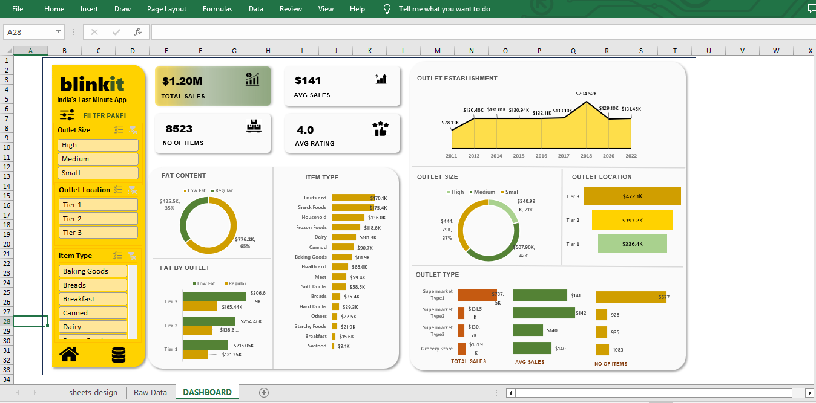
.

Slide 6
THANK YOU

